Slide 1
HARBOR HILL SCHOOL
MAKING GOOD CHOICES

Slide 2
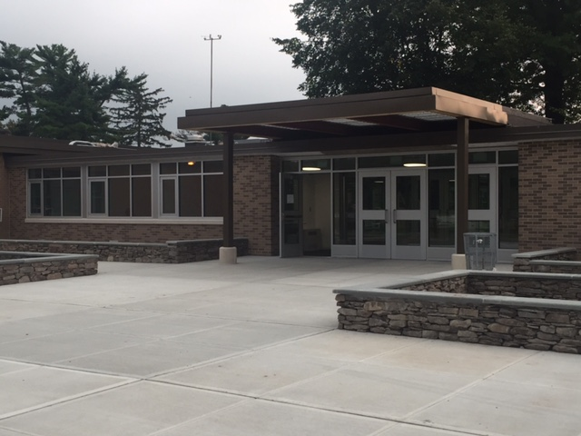
Welcome to the
Harbor Hill School !

Slide 3
Harbor Hill students…
Come to school every day
Arrive on time
8:05 AM

Slide 4
Be Prepared
Bring the right supplies
Complete all classwork
Complete all homework
Hand in projects on time
Bring instruments to school

Slide 5
Dress Appropriately
Be prepared for outdoor recess especially on cold days.
Wear comfortable sneakers with laces, velcro or z-straps to be able to participate safely in recess and P.E.

Slide 6
Bathroom Rules
Get permission from an adult
Keep the bathroom clean
Throw all paper into the garbage pail

Slide 7
Cafeteria Rules
Remember to:
- Stay in your seat
Talk quietly
Eat your own food- no sharing
Clean up your mess
Line up quickly and quietly at the end.

Slide 8
Recess Rules
Listen to the adults in charge
Disagreements over game decisions become an automatic ‘Do Over’
will
Speak nicely to each other
Use words to solve problems

Slide 9
Recess Rules
Include everyone
Use the equipment appropriately
Games involving physical contact are not allowed such as tag and football
Ask an adult for permission to enter school
10

Slide 10
Games and Activities
Soccer
Wallball
Kickball
Basketball
Playground equipment

Slide 11
Keep It Home
Toys
Cell phones
Electronics
Video watches

Slide 12
Hallway Rules
Walk quietly
Keep to the right
Follow the directions of adults
Respect work on display

Slide 13
Bus Rules
Walk on and off of the bus
Keep all of your things on your lap
Keep the bus clean

Slide 14
Bus Rules
Be kind to the bus driver and the students
Remain seated at all times
Use appropriate language

Slide 15
Kindness Counts
Physical
Hitting, tripping, pushing
Damaging/ stealing other’s belongings
Verbal
Name calling, teasing
Making discriminatory remarks
Verbally threatening

Slide 16
Kindness Counts
Emotional
Excluding or threatening to exclude
Spreading rumors, gossiping
Using threatening looks or gestures
Cyberbullying
Use of the internet or cell phone to hurt
other people’s feelings

Slide 17
Consequences
Meeting with Mrs. Hazen or Mr. Gabrus
Phone call home
Meeting with parents, Mrs. Hazen and
Mr. Gabrus
Loss of recess time
Removal from classroom
Replace damaged property
Bus seat reassignment
Removal from the bus

Slide 18
If someone is being unkind to you, what can you do?
Tell the person, in a firm voice, to
stop
Stay calm, take deep breaths and
walk away
Ask an adult for help
20

Slide 19
Bystanders Can Be
Upstanders
Tell the person who is bullying to
stop
Band together as a group
Avoid joining in
Reach out to students who are alone and help
Ask an adult for help

Slide 20
The No Place For Hate Pledge

